Slide 1
Immigration 2017
Stay Informed
Presented By:
Catholic Charities of Idaho
Immigration Legal Services Program

Slide 2
Catholic Charities of Idaho
Catholic Charities of Idaho offers a variety of social services that improve lives, promote dignity, and build individual and family self-sufficiency. Founded in 2000, we prioritize service to those most in need, promote healthy family life, stable relationships, and social inclusion, offer culturally competent services to newcomer communities, and foster safety, trust, collaboration, and empowerment as the key guiding principles of our work with clients.
Catholic Charities of Idaho (CCI) serves all people regardless of religion, age, gender, disability, race/ethnicity, income or background. Culturally specific services are available for immigrant and refugee communities.

Slide 3
What is our vision?
Catholic Charities of Idaho commits to alleviate, reduce, and end poverty for those we serve.

Slide 4
CCI Trinity of
Core Services
Immigration Legal
Services
Community Linkages
Service Integration
Linkage
Community Linkages
Linkage
Service Integration
Linkage
Client
Education & Skill
Building
Family & Individual
Counseling
Linkage
Linkage
Linkage
Service Integration
Community Linkages
Mission & Program Committee

Slide 5
Immigration Legal services
Catholic Charities of Idaho is one of the non-profit organizations in Idaho accredited by the Department of Justice(DOJ). We provide low cost immigration legal services to individuals eligible to receive immigration benefits. CCI provides legal consultations and assistance regarding most immigration matters including citizenship, family petitions, applications for victims of certain qualifying crimes such as domestic violence and other applications. Services are provided by DOJ Accredited Representatives.

Slide 6
Disclosure
The information provided in this presentation is generalized and provided for educational purposes ONLY, and should not be construed as legal advise on any specific case. Immigration law is complex and constantly being re-interpreted and challenged.
Every case is unique and therefore requires specific, individualized review by a licensed attorney or accredited representative before any legal conclusion should be reached.

Slide 7
Why is the Community worried?
The current panic is caused by a big shift in the
administration’s philosophy and enforcement of existing
deportation laws.
Although we haven’t seen massive evidence of widespread deportation, it has taken place and it appear to be more aggressive than the past administration.
Rhetoric during the Presidential Campaign
Fear, Uncertainty, Confusion

Slide 8

Why Is It Important to
Stay Informed About Immigration?
To approach a front-page issue sensitively and with accuracy
To create a more inclusive classroom
To establish dialogue and connections between diverse groups
To effectively advocate for immigrants and refugees in the community
To encourage positive understanding about immigrants

Slide 9
Immigration 101

Slide 10
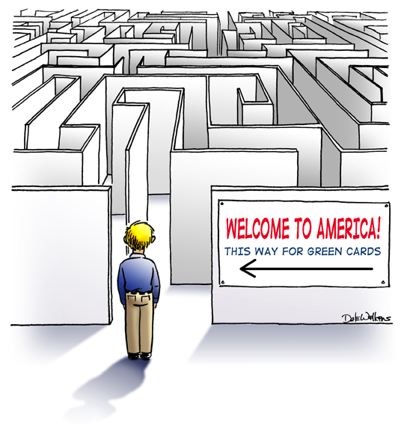

Slide 11
Categories of persons in the U.s.
United States Citizens (USC’s)
  By birth in the U.S. or to the U.S. parent
  By Naturalization or parent’s naturalization
Immigrants
  Lawful Permanent Residents (Green Card holders)
Nonimmigrants
  Asylees and Refugees
  Tourists, Students, U and T visa holders, and other temporary stay visas
  Persons here without authorization through unlawful entry or overstay of nonimmigrant status.

Slide 12
Differences between USC’s and lpr’s
United States Citizens
Legal Permanent Residents
Can Vote!
Can live outside of the U.S.
Cannot be Deported
Can petition for Spouse, Parents, Children (Unmarried, under 21), Adult Sons and Daughters (married or 21 or older), and Siblings.
Cannot Vote
Must live within the U.S. at least 6 months out of every year to retain residency (with exceptions)
Can be Deported
Can only petition for Spouse or Unmarried Children

Slide 13
What Is The Difference
Between a Refugee and an Asylee?
A refugee receives permission to come to the U.S. from outside of the country.
Refugees are resettled with the help of a refugee resettlement agency.
An asylee is already in the U.S. when s/he applies for protection.
Asylees have to prove that they have reason to fear persecution in their home country.

Slide 14
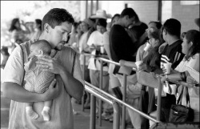
A Note About Family Reunification - The WAIT
The length of the wait will depend on:
  Whether the sponsor is a citizen or Lawful Permanent Resident
  What country the relative is from
  Type of relationship (ex: spouse comes sooner than a brother)
Example 1: A lawful permanent resident who wants to bring her husband and 2-year-old daughter from Mexico will have to wait approximately 5-6 years.
Example 2: A U.S. citizen who wants to bring his brother from the Philippines will have to wait approximately 23 years.

Slide 15
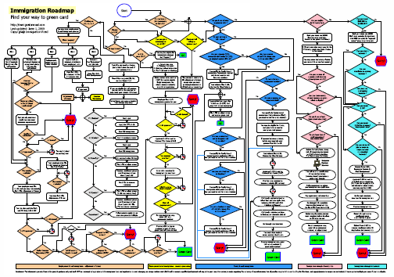
Find your way to a green card…

Slide 16
Domestic Violence is…
A pattern of behavior used to establish power and control over another person through fear and intimidation, often including the threat of use of violence.
We use the term “child victimization” to refer to child victims of domestic violence.
Immigration defines domestic violence as batter or extreme cruelty.

Slide 17
What challenges do immigrant survivors of domestic Violence and Serious crimes often facE?
Language and Cultural Barriers
Resources do not meet their cultural needs
Cultural Isolation and outcasting
Perception of Law Enforcement and Legal System
Fear of deportation and/or returning to their home country
Fear of losing their children

Slide 18
Arising issues:
Congress recognized that immigration laws were being used as tools of power and control over immigrant victims of domestic violence.
  Under traditional family-based immigration laws, immigrant victims’ status often depends on their relationship to their USC or LPR abuser.
Public Safety: Encouraging reporting and other cooperation assisted law enforcement in the investigation and prosecution of serious crimes.

Slide 19

OPTIONS FOR Victims of
Domestic Violence/Other Crimes
VAWA: The spouse, child, or parent of a LPR or USC who is battered or subject to extreme cruelty may file a self-petition independently of the abusive USC/LPR spouse of parent
  Ability to Adjust Status to Lawful Permanent Resident by themselves
  Children are included on parent’s self petition
  Employment Authorization
U-Visa: Temporary Visa available to individuals who are helpful to law enforcement in the investigation/prosecution of qualifying crime.
  Nonimmigrant status in the U.S. for up to 4 years.
  Employment Authorization
  Possibility of nonimmigrant status for family members
  Possibility of applying for permanent residence.

Slide 20
How the u-visa is different from vawa:
There is no requirement of an intimate or familial relationship between the perpetrator and the victim
There is no requirement that the perpetrator be a USC or LPR
Victim has been, is being, or will be helpful to a law enforcement agency.

Slide 21
OTHER OPTIONS FOR FAMILY MEMBERS
DACA
Deferred Action for Childhood Arrivals
On June 15, 2012, President Obama signed a memo calling for deferred action for certain undocumented young people who came to the U.S. as children and have pursued education or military service here. Applications under the program which is called Deferred Action for Childhood Arrivals (“DACA”) begin on August 15, 2012.

Slide 22
DACA and Higher education
DACA students are encouraged to obtain a higher education;
It depends on the institution.
Right now in the state, DACA students are considered in state;
Out of state DACA students.
FAFSA.
Undocumented students are not eligible for in- state tuition.

Slide 23
Protecting Family Members from Unauthorized Practice of Law
PROTECT YOUR FAMILY FROM PERMANENT DAMAGE TO THEIR CASE
Always seek legal advice from a licensed Attorney or Immigration Accredited Representative, not a Notary Public.
  Representatives have applied for accreditation with the Department of Justice, check their authorization at: https://www.justice.gov/eoir/recognition-accreditation-roster-reports
  Attorneys have graduated from a University and passed an State Bar Exam, check their licensure for the State of Idaho at: http://isb.idaho.gov/licensing/attorney_roster.cfm
Do not sign forms that are blank or you do not understand
Always get a receipt for your payment

Slide 24

QUESTIONS

Slide 25
Catholic Charities of Idaho
7255 W Franklin RD.
Boise, id 83709
Phone #: 208-345-6031
Thank you!

